Slide 1
Exploratory Data Analysis

Slide 2
INTRODUCTION
Objective: This analysis aims to explore the distribution of individual health indicators (univariate analysis) and their relationships with heart disease (bivariate analysis).
Data Source: Heart Disease Health Indicators Dataset https://drive.google.com/file/d/16DeG8mBHOMjYZYsuoc1r_7ivwMZf6mOA/view
Methodology: Using bar charts, pie charts, and pivot tables to identify trends

Slide 3
UNIVARIATE ANALYSIS
Definition: Univariate analysis refers to the examination of a single variable (or feature) at a time. It helps in understanding the distribution, central tendency (mean, median), and spread (variance, standard deviation) of the data.
Use: This analysis is used to summarize and describe the individual characteristics of a variable. It’s helpful in identifying patterns, outliers, and trends for that particular feature.
Example: In a heart disease dataset, univariate analysis could involve examining the distribution of BMI or age using histograms or box plots.

Slide 4
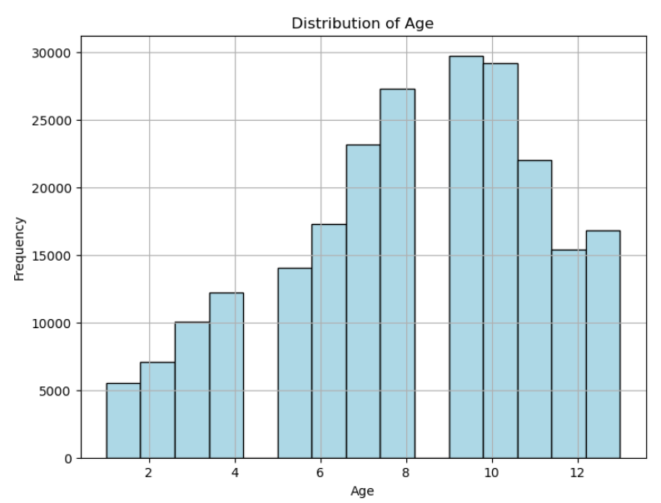
Chart: Histogram of Age
Finding: Age distribution is slightly skewed to the right, with a higher frequency of individuals between 6-10 years.
Key Insight: This age range might be a critical group to target for health interventions related to heart disease.

Slide 5
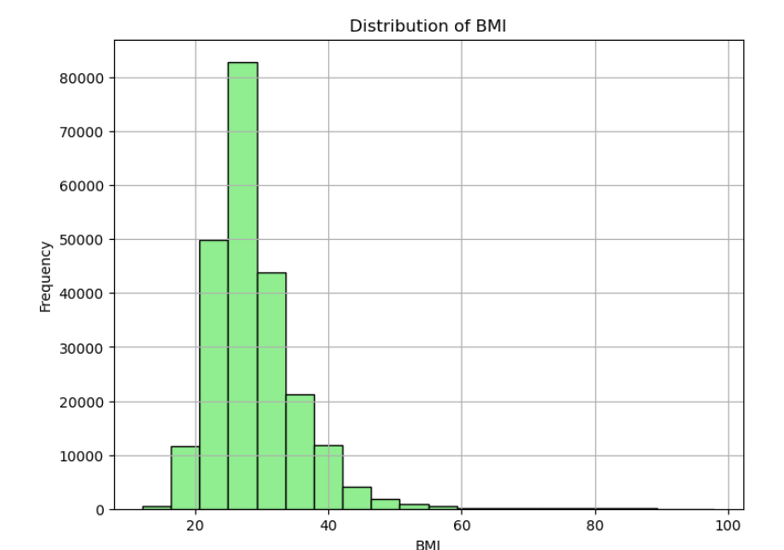
Chart: Histogram for BMI
Finding: The majority of the population has a BMI between 20 and 40, with a sharp decline after 40.
Key Insight: High BMI is linked to increased health risks, making it essential to focus on individuals with a BMI greater than 40 for targeted interventions.

Slide 6
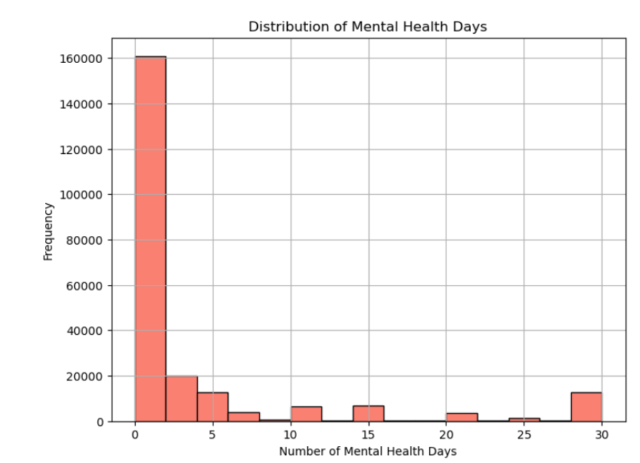
Chart: Histogram of Mental Health Days
Finding: Most individuals report fewer than 5 mental health days, but there are some outliers with significantly higher values.
Key Insight: Mental health issues might be concentrated among a smaller subset of the population, indicating a need for focused mental health support.

Slide 7
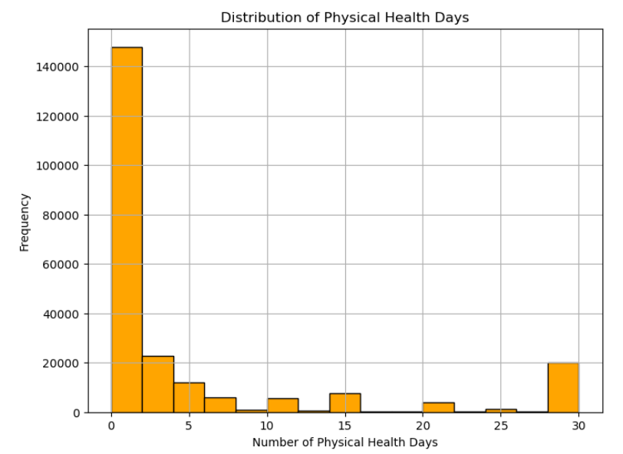
Chart: Histogram of Physical Health Days
Finding: Similar to mental health days, most individuals report fewer than 5 days of poor physical health.
Key Insight: Physical health declines are more pronounced in certain individuals, potentially impacting their overall heart health.

Slide 8
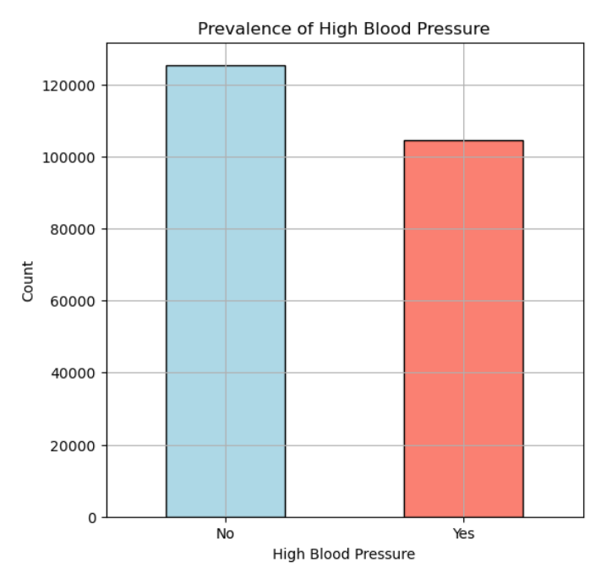
Chart: Bar Chart for High Blood Pressure
Finding: Approximately 50% of the population has high blood pressure.
Key Insight: High blood pressure is a significant factor in the dataset, with a clear link to heart disease risk.

Slide 9
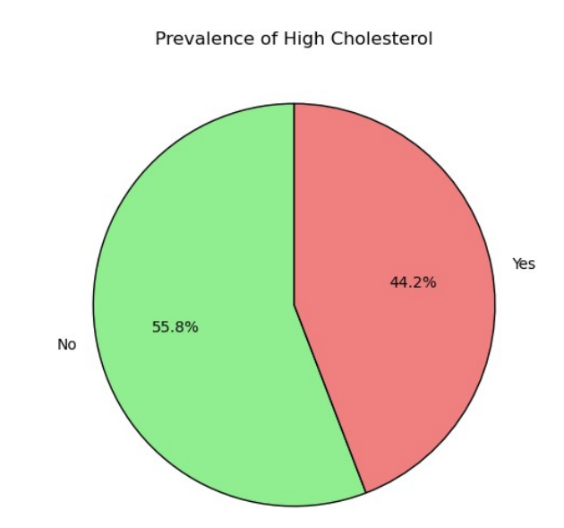
Chart: Pie Chart of High Cholesterol
Finding: 42.4% of individuals have high cholesterol.
Key Insight:
A significant portion of the population is at risk for heart-related issues, emphasizing the need for cholesterol management.

Slide 10
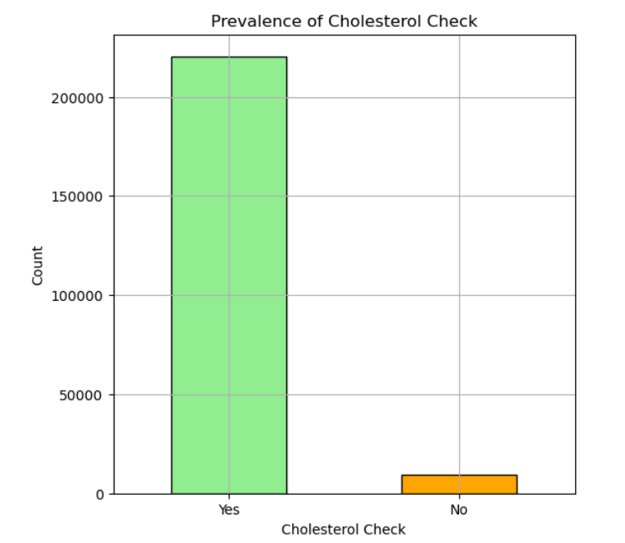
Chart: Bar Chart for Cholesterol Checks
Finding: The majority of the population has undergone a cholesterol check.
Key Insight: Regular cholesterol monitoring is crucial for early detection and prevention of heart disease.

Slide 11
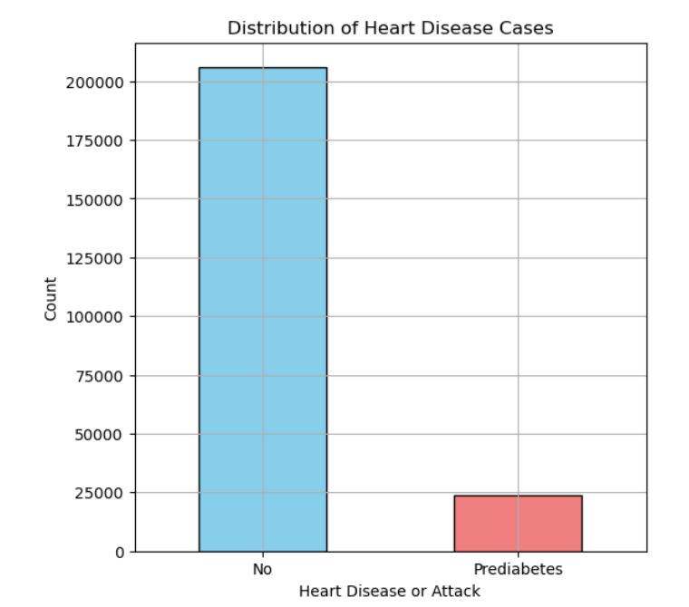
Chart: Bar Chart for Heart Disease Distribution
Finding: Most individuals do not have heart disease, with only a small proportion affected.
Key Insight: Heart disease is less common but remains a critical health concern.

Slide 12
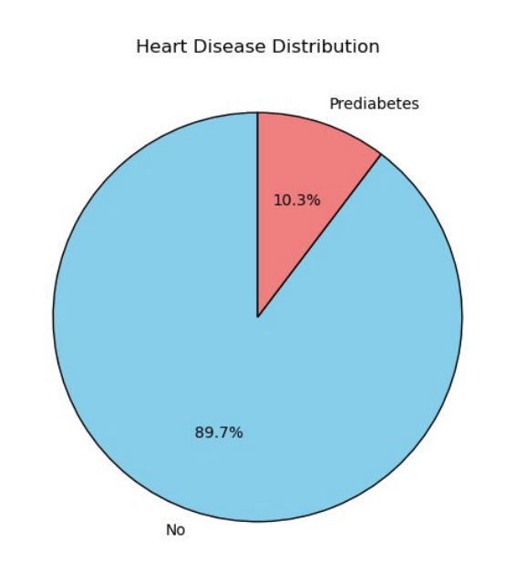
Chart: Pie Chart of Heart Disease Distribution
Finding: 10.3% of the population has signs of heart disease.
Key Insight: A notable portion of the population is affected by heart disease, highlighting the need for improved public health strategies.

Slide 13
BIVARIATE ANALYSIS
Definition: Bivariate analysis examines the relationship between two variables, allowing you to explore correlations or associations between them.
Use: Bivariate analysis is used to determine how one variable is affected by another. It’s often visualized through scatter plots, bar charts, or correlation matrices. This type of analysis is helpful for identifying relationships and dependencies.
Example: In the same heart disease dataset, a bivariate analysis might involve comparing BMI and heart disease occurrence (e.g., using a bar chart or correlation matrix to see if high BMI is associated with higher heart disease risk).

Slide 14
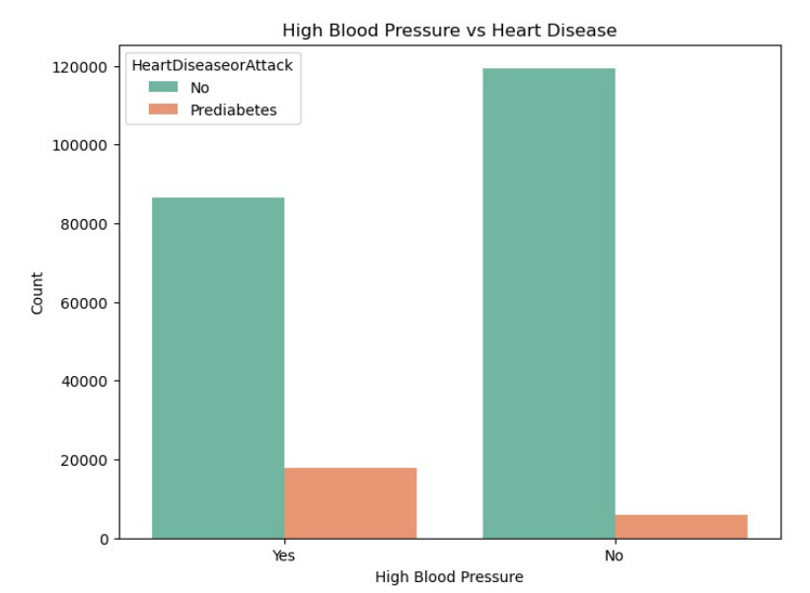
Chart: Bar Chart for High Blood Pressure vs Heart Disease
Finding: Individuals with high blood pressure are more likely to have heart disease.
Key Insight: There is a strong relationship between high blood pressure and the risk of developing heart disease.

Slide 15
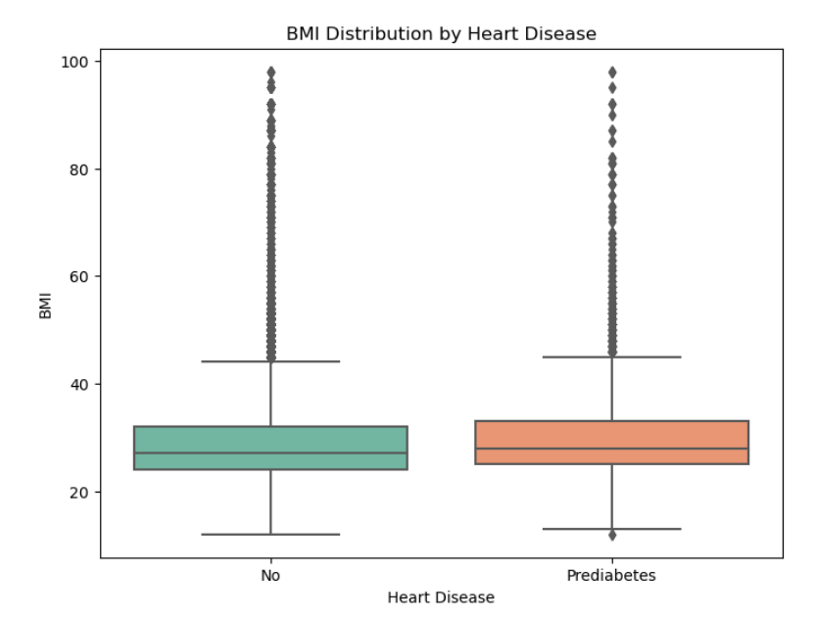
Chart: Boxplot for BMI Distribution by Heart Disease Status
Finding: Those with heart disease tend to have a higher BMI compared to those without.
Key Insight: Higher BMI is a significant risk factor for heart disease, with a clear correlation between increased BMI and the likelihood of heart disease.

Slide 16
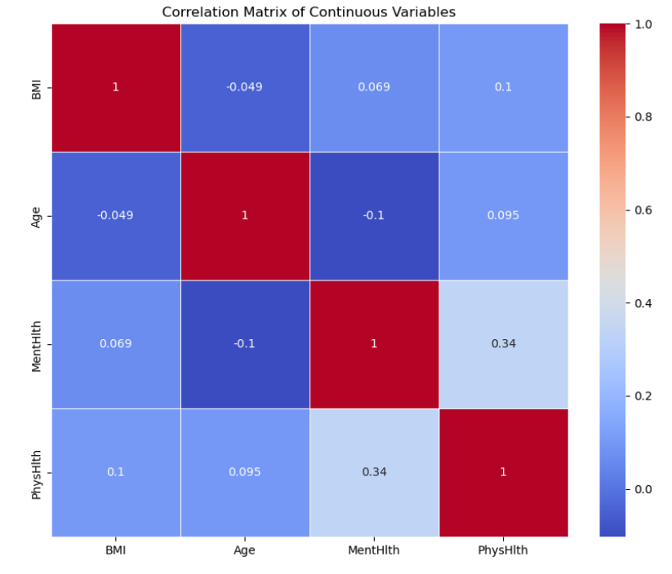
Chart: Correlation Matrix of Continuous Variables
Finding: Moderate correlation between physical health and heart disease, while age and BMI show weaker correlations.
Key Insight: Some variables are moderately related to heart disease; however, age and BMI still warrant consideration in further analyses.

Slide 17
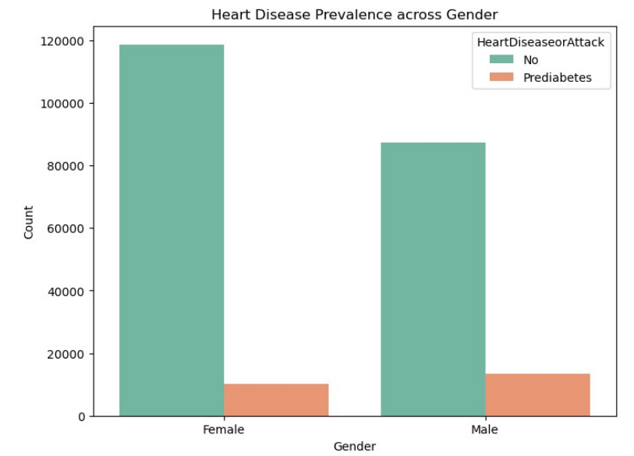
Chart: Bar Chart for Heart Disease by Gender
Finding: Heart disease is less common in both genders, but one gender shows a higher prevalence.
Key Insight: Gender-specific health interventions may be needed to address differences in heart disease risk.

Slide 18
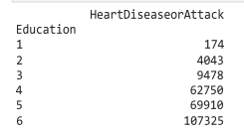
Chart: Pivot Table
Finding: Higher education levels have more individuals, but heart disease cases don't necessarily increase proportionally.
Key Insight: The dataset has more people with higher education, but heart disease prevalence doesn’t rise sharply with education.

Slide 19
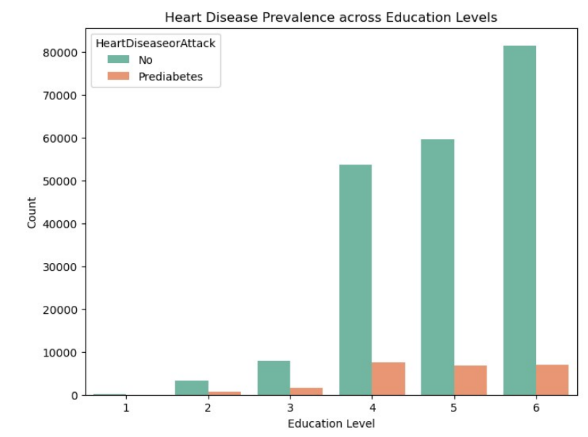
Chart: Bar Chart
Finding: Heart disease remains low across all education levels, with a slight increase at higher levels.
Key Insight: Higher education shows a small increase in heart disease, suggesting other factors may play a bigger role.

Slide 20
Thank You!

